Slide 1

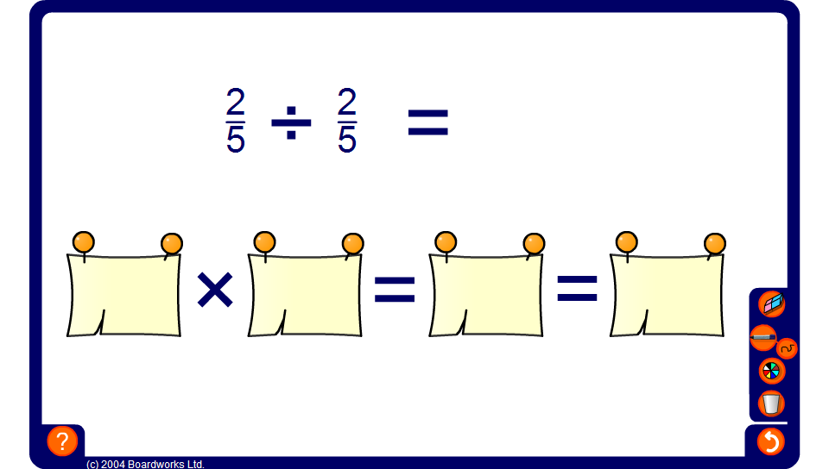

Dividing fractions
Notes:
Practice dividing fractions mentally. Ask pupils for the solution to the calculation, and then check it by revealing the answer.

